Slide 1

MTP-2
Hardware Accelerated Network Traffic Analytics
Baddala Sai Kumar Reddy
Mailavaram Parthasaradhi Reddy
Department of Computer Science and Engineering
Guided By
Prof.Ayon Chakraborty

Slide 2
Problem Statement
Need for Network Traffic Classification:
Security Enforcement: Detect threats and block malicious traffic
QoS Management: Ensure smooth performance for latency-sensitive apps
Policy Control: Enforce usage policies at the network edge
Anomaly Detection: Catch abnormal traffic behaviors early
Traffic Optimization: Route and allocate bandwidth efficiently
Current software-based methods suffer from latency and limited performance under high throughput.
A hardware-accelerated solution is needed for scalable, efficient traffic classification at the network edge.

Slide 3
Proposed Solution
Use Xilinx Zynq-7000 SoC combining ARM processors and programmable logic.
Capture and preprocess packets on ARM processor (PS) for feature extraction.
Synthesize the DNN model with hls4ml and HLS tools for FPGA.
Deploy quantized DNN in programmable logic (PL) for real-time classification.
Achieve line-rate classification with high throughput and power efficiency.

Slide 4

What is hls4ml and Why It Matters
Model Translation: Converts trained ML models into High-Level Synthesis (HLS) code for hardware.
Optimization: Supports compression like quantization for efficient FPGA and ASIC deployment.
Hardware-Friendly: Bridges ML design with FPGA implementation for real-time, low-latency inference.
Customization: Tailors latency, throughput, and resource usage to embedded system constraints.

Slide 5




Testbed Validation with MNIST on FPGA
Purpose
Verify hardware setup using MNIST digit dataset for functional validation.
Setup
Simple DNN trained on 28×28 grayscale MNIST images for initial testing.
Model
Quantized and synthesized with hls4ml for FPGA deployment efficiency.
Deployment
Deployed on PYNQ-Z2 board (Zynq-7000 SoC) using Vivado HLS tools.

Slide 6
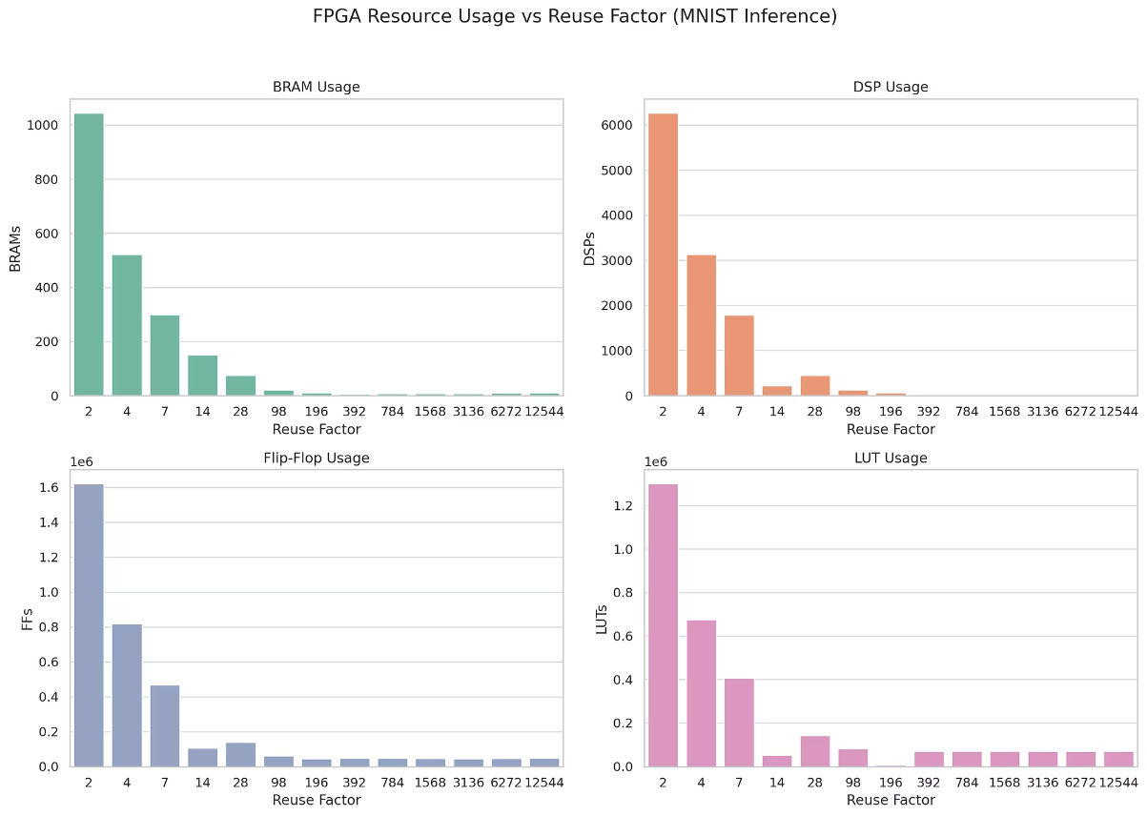

Slide 7





Pipeline
Packet Capture & Preprocessing
Packets are captured live or from stored files in the Processing System.
Feature Extraction
Key header fields and sizes are extracted to form feature vectors.
Transfer to Programmable Logic
Features are sent to FPGA logic via high-speed AXI/DMA interface.
DNN Inference in Programmable Logic
A quantized DNN model classifies traffic in real time on FPGA.
Results Back to Processing System
Predictions return to the processor for logging or immediate response.

Slide 8
Key Features
Feature Type
Description
Use Case
Flow Duration
Time between first and last packet in a flow
Chat (short) vs Streaming (long)
Inter-Arrival Time (IAT)
Min, max, mean, std of time between packets
Bursty vs Idle Traffic
Active/Idle Periods
Stats of continuous burst and silent gaps
Messaging vs Video Stream
Throughput
Packets/sec or Bytes/sec over 2s flow window
Bandwidth usage patterns
Packet Count (Optional)
Number of packets per flow
Bulk data transfer detection
Design Choice
Window Duration: 2 seconds per flow
Focus: Behavioral patterns over encrypted traffic (no payload analysis)

Slide 9
PS Based Feature Extraction Pipeline
Create Feature Vector
Feature Extraction
Generate 13 total features per flow for encrypted traffic classification.
Flow Grouping
Calculate inter-arrival times, throughput, activity, and idle period stats.
Packet Parsing
Organize packets into flows using 5-tuple within a 2-second window.
Extract IP headers, ports, protocols, and timestamps from packets.

Slide 10

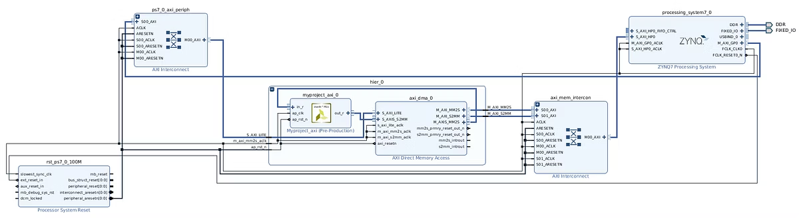




Real-Time Inference on PYNQ – DL Model in PL
Lightweight MLP:
Training Data:
A model is deployed on PYNQ-Z2 FPGA’s Programmable Logic (PL).
Offline training using UNB CIC VPN dataset with encrypted and unencrypted traffic.
Deployment Tools:
Model Outputs:
Utilizes hls4ml and custom HLS accelerators for hardware implementation.
Classifies traffic into Browsing, Chat, Streaming, File Transfer, and VoIP categories.

Slide 11
Challenges with Real-Time Traffic Capture on PYNQ
Original Plan: NetfilterQueue (NFQUEUE) Pipeline
Used to intercept live traffic in user space via kernel hooks
C++ feature extractor is built around real-time NFQUEUE callbacks
Deployment Roadblock on PYNQ-Z2
NFQUEUE is not supported on PYNQ Linux (Petalinux-based)
Missing kernel features:
CONFIG_NETFILTER, CONFIG_NF_CONNTRACK, nfnetlink_queue module
PYNQ’s lightweight OS omits these to stay minimal and efficient
Impact
Real-time packet-to-flow pipeline cannot run on PYNQ-Z2
Live classification not possible without significant kernel modifications

Slide 12


Workarounds and Final Resolution
Workarounds Explored
Raw Sockets / libpcap (Accepted):
Kernel Rebuild (Rejected):
Compatible with PYNQ Linux
Complex cross-compilation
Allows passive packet capture for offline processing
Risk of bricking the board
Tight deployment timeline

Slide 13
Final Workflow: PCAP-Based Classification
Traffic captured using tcpdump on another system → saved as .pcap
.pcap file transferred to PYNQ-Z2
C++ code parses packets and extracts features offline
Features are passed to the FPGA classifier running in PL

Slide 14
Hardware Inference Results on PYNQ-Z2
Metric
Value
Number of Test Samples
7,659
Input Feature Dimensions
13
Total Classification Time (PS wall-clock)
0.0272 seconds
FPGA-only Inference Time (PL latency)
0.0256 seconds
Effective Throughput
298,864 inferences/sec
Resource Type
Used
Available
Utilization (%)
BRAM 18K
17
280
6%
DSP48E
62
220
28%
FF (Flip-Flops)
46,292
106,400
43%
LUT (Look-Up Tables)
45,680
53,200
85%

Slide 15
Conclusion
Functional Testbed for Network Traffic Classification
Working End-to-End System
A complete network traffic classification pipeline has been designed, trained, and deployed on the PYNQ-Z2 board
Testbed is Ready for Future Integration
The infrastructure is in place for:
Real-world traffic evaluation
Future integration of live capture on more capable edge systems
Provides a robust and scalable foundation for edge-based, encrypted traffic classification

Slide 16
Thank You

